Slide 1
EMPLOYEES’ REVIEWS: WHAT IS NEW?
HA TRAN
GALVANIZE DATA SCIENCE IMMERSIVE
Notes:
Hi everyone, I am Ha, a data scientist. Today, I will tell you some new things about employees’ reviews.

Slide 2
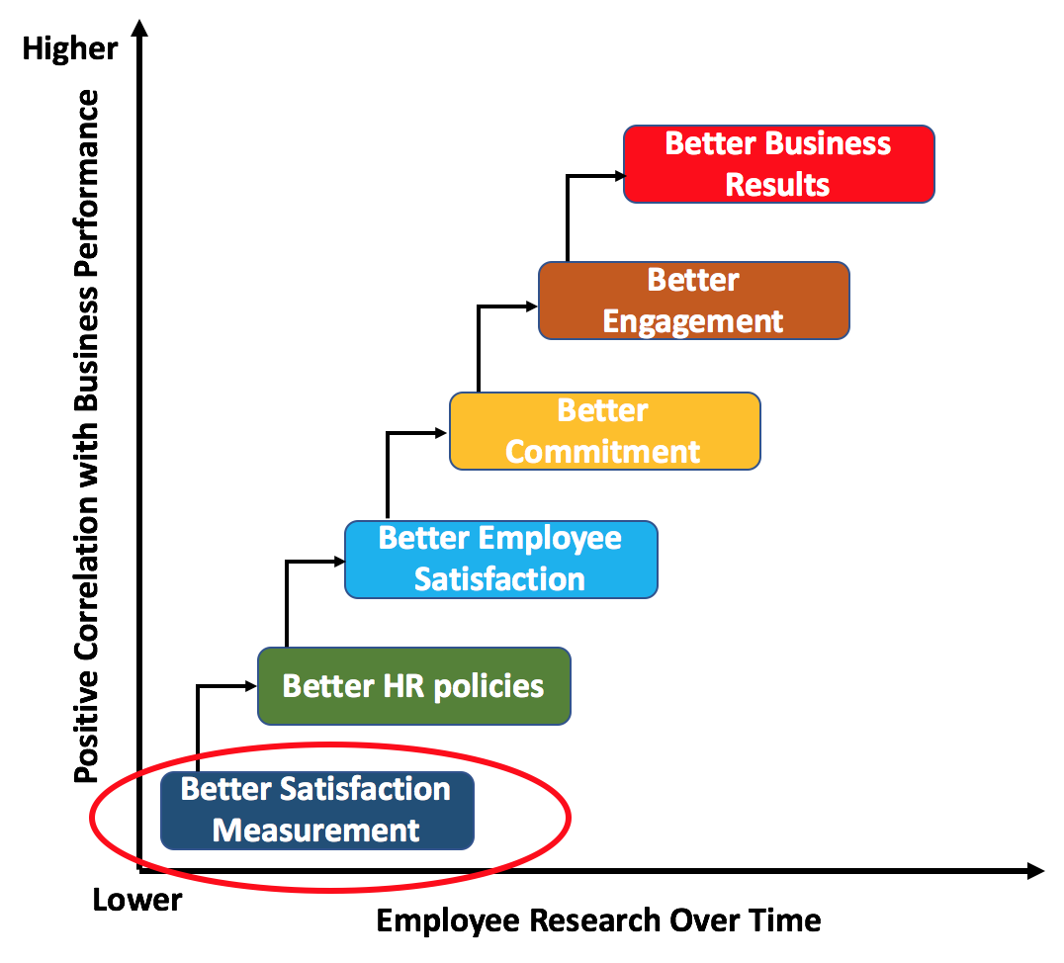
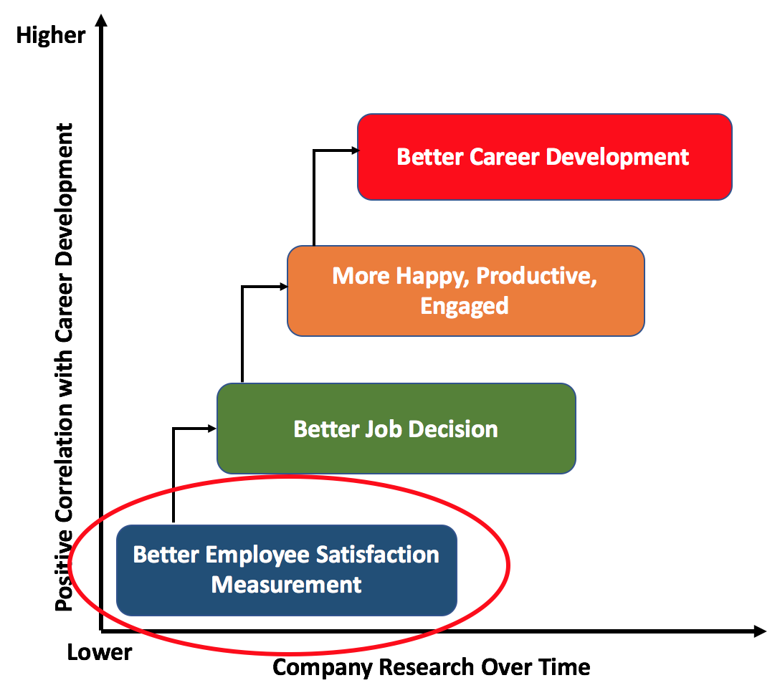

Why is employee satisfaction measurement important?
Employers
Job Seekers
Notes:
Why is employee satisfaction measurement important to both employeers and job seekers? Because, better satisfaction measurement helps the companies have better HR policies, and from that, companies can have better business results. To job seekers, better employee satisfaction measurement can help them to have better job decision that is important in career development.

Slide 3
Why is external employee rating data important?
Employee Satisfaction Measurement
Internal Employee Satisfaction Rating Survey
External Employee Satisfaction Rating Site (e.g, Indeed.com, glassdoor.com)
Better survey design
Better former employee data
Higher current employee participation
Cross-companies comparison ability
Lower confidentiality
X
Anonymous data
No cross-companies comparison
Public data - everyone can access
X
No public data
X
X
Convenient employee samples
Notes:
While there are two sources for employee satisfaction measurement, the most important advantage of external employee satisfaction rating sites as Indeed.com or glassdoor.com is that data is public. So everyone can access.

Slide 4
What are the problems of overall rating information?
Company A
Company B
Notes:
Although the overall ratings of employee review sites are quite clear, it can cause misleading due to some problems.

Slide 5
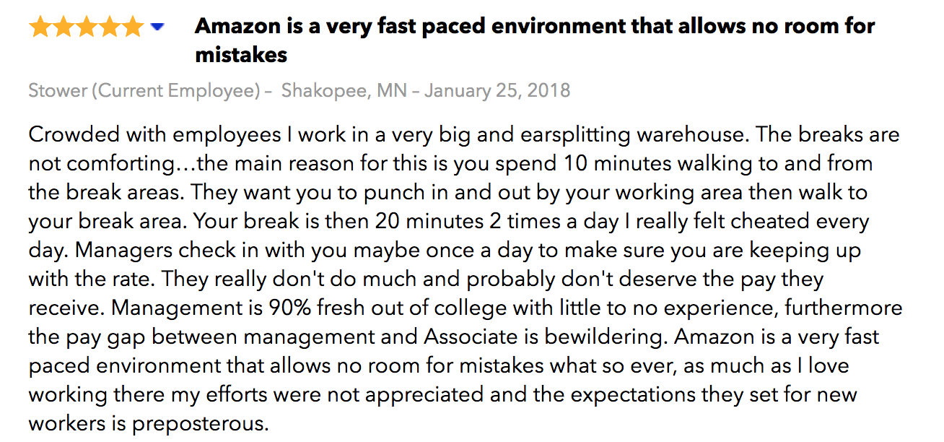
What are the problems of external rating data?
Discrepancy between the rating score and text information
Notes:
First, there is discrepancy between the rating score and text information. With this example, the review can have 5* but have negative comment in text.

Slide 6
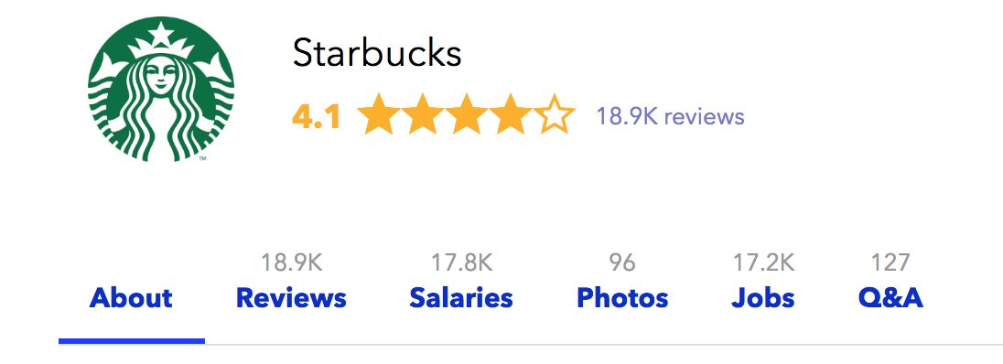
What are the problems of external rating data?
Discrepancy between the rating score and text information
Many reviews with possible very long text
Notes:
Second, it is impossible for job seekers to go through all text reviews when the numbers of reviews can be 18,000 and one review can be this long.

Slide 7
What are the problems of external rating data?
Discrepancy between the star score and text information
Many reviews with possible very long text

Slide 8
This project will solve these problems!
Notes:
This project, using powerful machine learning techniques, will solve these problems

Slide 9
OBJECTIVES
Objective 1: test hypothesis
Determine if the text comments provide more insight employees’ satisfaction information
Objective 2: develop back-end product
Construct a new rating scale by combining “text” scores and standard 1 - 5 rating scores
KMeans
PCA
Logistic Regression
Decision Tree
Ada Boosting
Naive Bayes
Random Forest
Gradient Boosting
Objective 3: develop front-end product
Develop a recommender system for each job seeker
Sentiment Analysis (Natural Language Processing) for text review scoring.
“Revised” Matrix Factorization
Web-app
Notes:
There are three objectives in this projects.
First, I tested hypothesis that the text reviews will provide more insightful information on employee satisfaction.
Second, I constructed a new rating scale by combining “text” scores and standard 1-5 rating scores.
Third, I developed a recommender system for the specific job seeker.

Slide 10
DATA SOURCE
Indeed.com: 33 companies
Web-scraping !!!!!
~60,000 reviews
Employment status
Date, month, year
Location
Position
Text reviews
Ratings
Offices in Seattle
Data scientist/ analyst positions
> 300 reviews
2011 - 2018
Notes:
Employee reviews data of 33 companies that recruit data scientist and analyst positions were scraped from indeed. com

Slide 11
OBJECTIVES
Objective 1: test hypothesis
Determine if the text comments provide more insight employees’ satisfaction information
Objective 2: develop back-end product
Construct a new rating scale by combining “text” scores and standard 1 - 5 numeric scores
KMeans
PCA
Logistic Regression
Decision Tree
Ada Boosting
Naive Bayes
Random Forest
Gradient Boosting
Objective 3: develop front-end product
Develop a recommender system for the specific job seeker
Sentiment Analysis (Natural Language Processing) for text review scoring.
“Revised” Matrix Factorization
Web-app

Slide 12

Objective 1: text comments provide further satisfaction information
Surrogate predictor of employee satisfaction: Y = employees staying/leaving the companies.
Compare the performances of nested models: with text vs. without text information.
Logistic Regression
Decision Tree
Ada Boosting
Naive Bayes
Random Forest
Gradient Boosting
Location, Date, Position, Review Scores, ...
Y
Location, Date, Position, Review Scores, ...
Text
Y
KMeans
Notes:
With my first objectives, I used the information of employees staying/leaving companies as an imperfect surrogate variable for employee satisfaction.
Two nested predicve models - model without text and with text were compared.

Slide 13
Objective 1: text comments provide further satisfaction information
Gradient Boosting AUC
CONCLUSION: TEXT REVIEWS PROVIDE FUTHER SATISFACTION INFORMATION!!!
Notes:
And the model with text consistently predict better the surrogate information of employee satisfaction. So, we can conclude that text comment provide further satisfaction information.

Slide 14
OBJECTIVES
Objective 1: test hypothesis
Determine if the text comments provide more insight employees’ satisfaction information
Objective 2: develop back-end product
Construct a new rating scale by combining “text” scores and rating scores
KMeans
PCA
Logistic Regression
Decision Tree
Ada Boosting
Naive Bayes
Random Forest
Gradient Boosting
Objective 3: develop front-end product
Develop a recommender system for the specific job seeker
Sentiment Analysis (Natural Language Processing) for text review scoring.
“Revised” Matrix Factorization
Web-app

Slide 15
Objective 2: Construct a new rating scale = f(“text” ,1 - 5 rating)
Text → NLP (Sentiment Analysis) → “text” score
Rating (1* - 5*) -------------------------> “rating” score
Final Score
Notes:
Due to this conclusion, I constructed a new employee satisfaction score as a function of “text” and rating score.
The text reviews were processed using natural language processing sentiment analysis to convert from text format to numeric format.

Slide 16
Objective 2: Construct a new rating scale = f(“text” ,1* - 5* scores)
Top 1 companies for work-life balance, compensation-benefit, job security, management, culture.
Work life balance
Compensation & benefit
Management
Culture
Notes:
And the companies will have their new own rating scores on 5 features. This is an example of Compensation and benefit score ranking.

Slide 17
OBJECTIVES
Objective 1: test hypothesis
Determine if the text comments provide more insight employees’ satisfaction information
Objective 2: develop back-end product
Construct a new rating scale by combining “text” scores and standard 1 - 5 numeric scores
KMeans
PCA
Logistic Regression
Decision Tree
Ada Boosting
Naive Bayes
Random Forest
Gradient Boosting
Objective 3: develop front-end product
Develop a recommender system for each job seeker
Sentiment Analysis (Natural Language Processing) for text review scoring.
“Revised” Matrix Factorization
Web-app
Notes:
Utilizing the new text-rating combing score, I developed a recommender system for each job seeker.

Slide 18
Objective 3: recommender system and web-app for each job seeker
Features
”Adjusted” Matrix Factorization method:
Both ”text” and rating scores were combined in generating feature matrix
Temporal, institutional, personal factors were also incorporated into missing imputation
Companies
Notes:
For the recommender system, I used Matrix Factorization method but to improve the recommendation capability, I have two modifications. First, I used both “text” and rating scores in generating feature matrix instead of text review only. Second, temporal, institutional, personal factors were also incorporated into missing imputation.

Slide 19
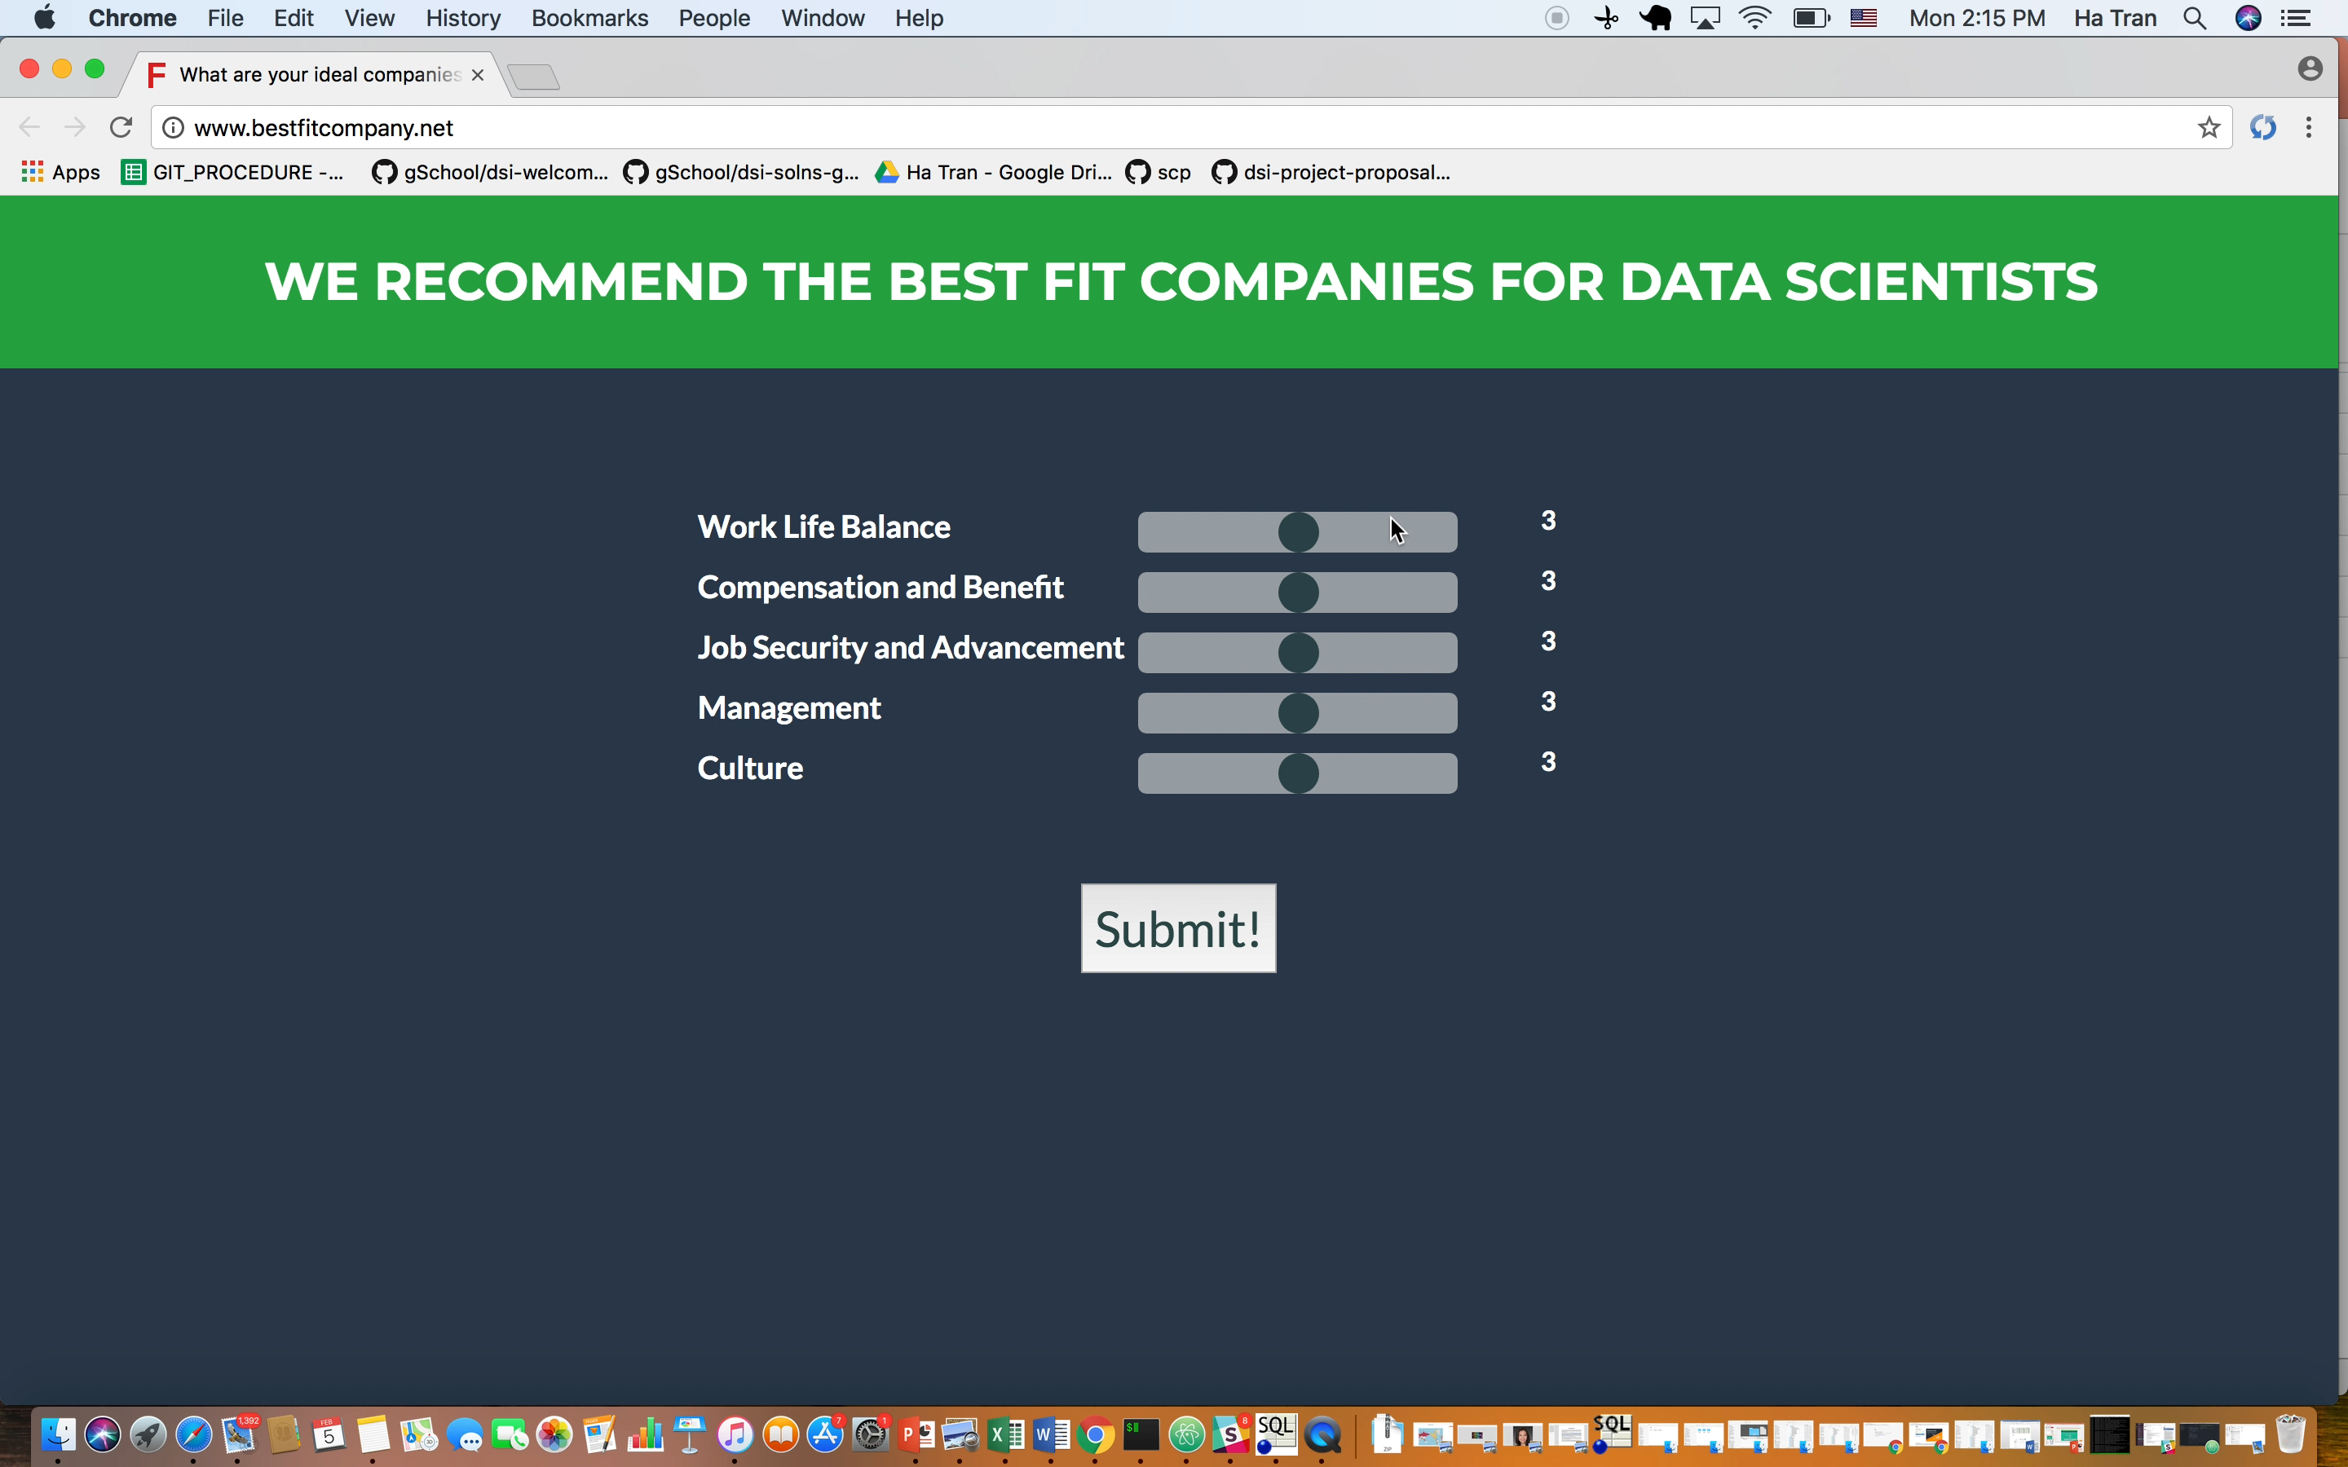
Objective 3: recommender system and web-app for each job seeker
bestfitcompany.net
Notes:
A website has been launched in which, job seeker can give their weight for each features and the website provides them the list of best fit companies
☺

Slide 20
Future Direction
1. Develop web-app version 2 including companies’ scores and information.
2. Estimate overall score using spatial temporal mixed model.
3. Forecast employees’ ratings for each companies.
Ha Tran, Data Scientist
Email: hatran84@outlook.com
Phone: (206) – 771 – 4762
Linkedin: https://www.linkedin.com/in/ha-t-tran/
Github: https://github.com/ngocha61084
Notes:
And these are my future directions for my capstone project

